Slide 1
Software Requirements Engineering
Lecture 10 and 11
Engr. Sara Rehmat

Slide 2
2. Scope and limitations
A software project should define its scope and limitations. You need to state both what the solution being developed is (scope) and what it is not (limtitations).
The first step to controlling scope creep is to define the project’s scope.
At the highest level, scope is defined when the customer decides which business objectives to target.
At a lower level, scope is defined at the level of features, user stories, use cases, or events and responses to include.
Scope ultimately is defined through the set of functional requirements planned for implementation in a specific release or iteration.
At each level, the scope must stay within the bounds of the level above it. For example, in-scope user requirements must map to the business objectives, and functional requirements must map to user requirements that are in scope.

Slide 3
2.1 Major Features
List the product’s major features or user capabilities, emphasizing those that distinguish it from previous or competing products.
Think about how users will use the features, to ensure that the list is complete and that it does not include unnecessary features that sound interesting but don’t provide customer value.
Give each feature a unique and persistent label to permit tracing it to other system elements. You might include a feature tree diagram.

Slide 4
2.2 Scope of the initial release
Summarize the capabilities that are planned for inclusion in the initial product release.
Often defined in terms of features,user stories, use cases, use case flows, or external events.
Describe the quality characteristics
Avoid the temptation to include every feature that any ­potential customer might eventually want in release 1.0.
Bloatware and slipped schedules are common outcomes of such insidious scope stuffing.
Focus on those features that will provide the most value, at the most acceptable cost, to the broadest community, in the earliest time frame.

Slide 5
2.3 Scope of the subsequent releases
If you are following an iterative or incremental life cycle, build a release roadmap that indicates which functionality chunks will be deferred and the desired timing of later releases.
The farther out you look, the fuzzier these future scope statements will be and the more they will change over time.
Short release cycles provide frequent opportunities for learning based on customer feedback.

Slide 6
2.4 Limitations or exclusions
List any product capabilities or characteristics that a stakeholder might expect but that are not planned for inclusion in the product or in a specific release.
List items that were cut from scope, so the scope decision is not forgotten.
  Maybe a user requested that she be able to access the system from her phone while away from her desk, but this was deemed to be out of scope. State that explicitly in this section: “The new system will not provide mobile platform support.”

Slide 7
3. Business context
Stakeholder profiles
Project Priorities
Deployment Considerations

Slide 8
3.1 Stakeholder profiles
The stakeholder profiles describe different categories of customers and other key stakeholders for the project.
Each stakeholder profile should include the following information:
The major value or benefit that the stakeholder will receive from the product. Stakeholder value could be defined in terms of:
  Improved productivity.
  Reduced rework and waste.
  Cost savings.
  Streamlined business processes.
  Automation of previously manual tasks.
  Ability to perform entirely new tasks.
  Compliance with pertinent standards or regulations.
  Improved usability compared to current products
Their likely attitudes toward the product.
Major features and characteristics of interest.
Any known constraints that must be accommodated.

Slide 9
3.2 Project priorities
To enable effective decision making, the stakeholders must agree on the project’s priorities.
One way to approach this is to consider the five dimensions of features, quality, schedule, cost, and staff
Each dimension fits in one of the following three categories on any given project:
  Constraint A limiting factor within which the project manager must operate
  Driver A significant success objective with limited flexibility for adjustment
  Degree of freedom A factor that the project manager has some latitude to adjust and balance against the other dimensions

Slide 10
3.3 Deployment Considerations
Summarize the information and activities that are needed to ensure an effective deployment of the solution into its operating environment.
  Describe the access that users will require to use the system, such as whether the users are distributed over multiple time zones or located close to each other. State when the users in various locations need to access the system.
  If infrastructure changes are needed to support the software’s need for capacity, network access, data storage, or data migration, describe those changes.
  Record any information that will be needed by people who will be preparing training or modifying business processes in conjunction with deployment of the new solution.

Slide 11
Scope Representation Techniques
The models described in this section can be used to represent project scope in various ways.
You don’t need to create all of these models; consider which ones provide the most useful insight for each project.

Slide 12
Context Diagrams
The context diagram visually illustrates scope i.e. the boundary between the system you’re developing and everything else in the universe.
It identifies external entities (also called terminators) outside the system that interface to it in some way, as well as data, control, and material flows between the terminators and the system.

Slide 13
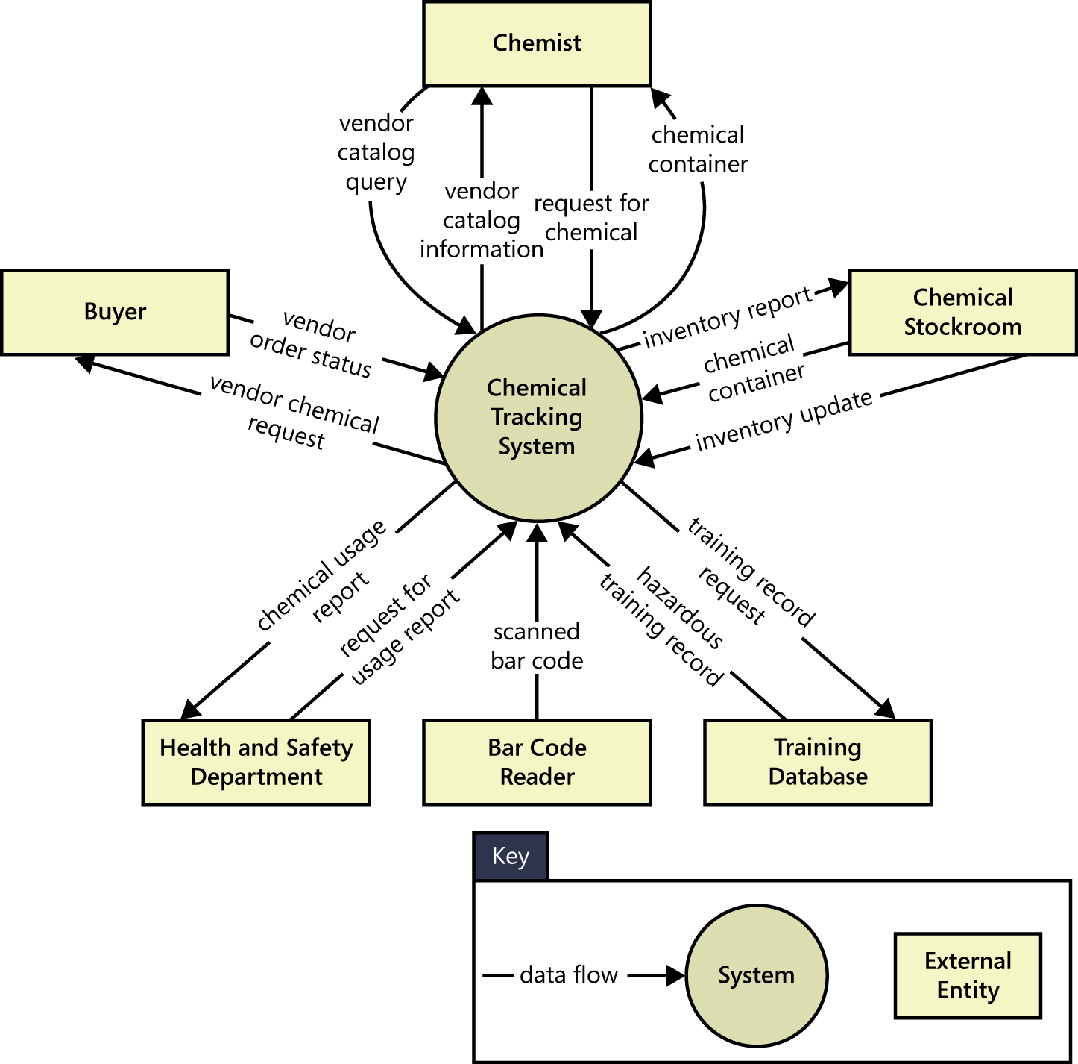

Slide 14
Ecosystem map
An ecosystem map shows all of the systems related to the system of interest that interact with one another and the nature of those interactions.
An ecosystem map represents scope by showing all the systems that interconnect and that therefore might need to be modified to accommodate your new system.
Ecosystem maps differ from context diagrams in that they show other systems that have a relationship with the system you’re working on, including those without direct interfaces.
You can identify the affected systems by determining which ones consume data from your system. When you reach the point that your project does not affect any additional data, you’ve identified the scope boundary of systems that participate in the solution.

Slide 15
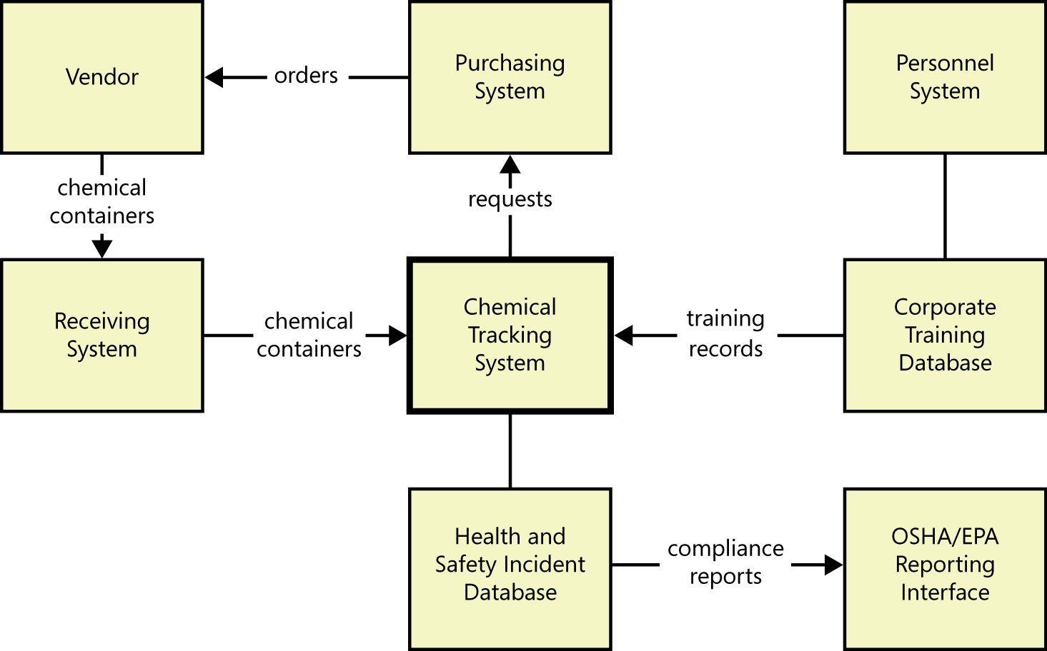

Slide 16
Feature Tree
A feature tree is a visual depiction of the product’s features organized in logical groups, hierarchically subdividing each feature into further levels of detail.

Slide 17
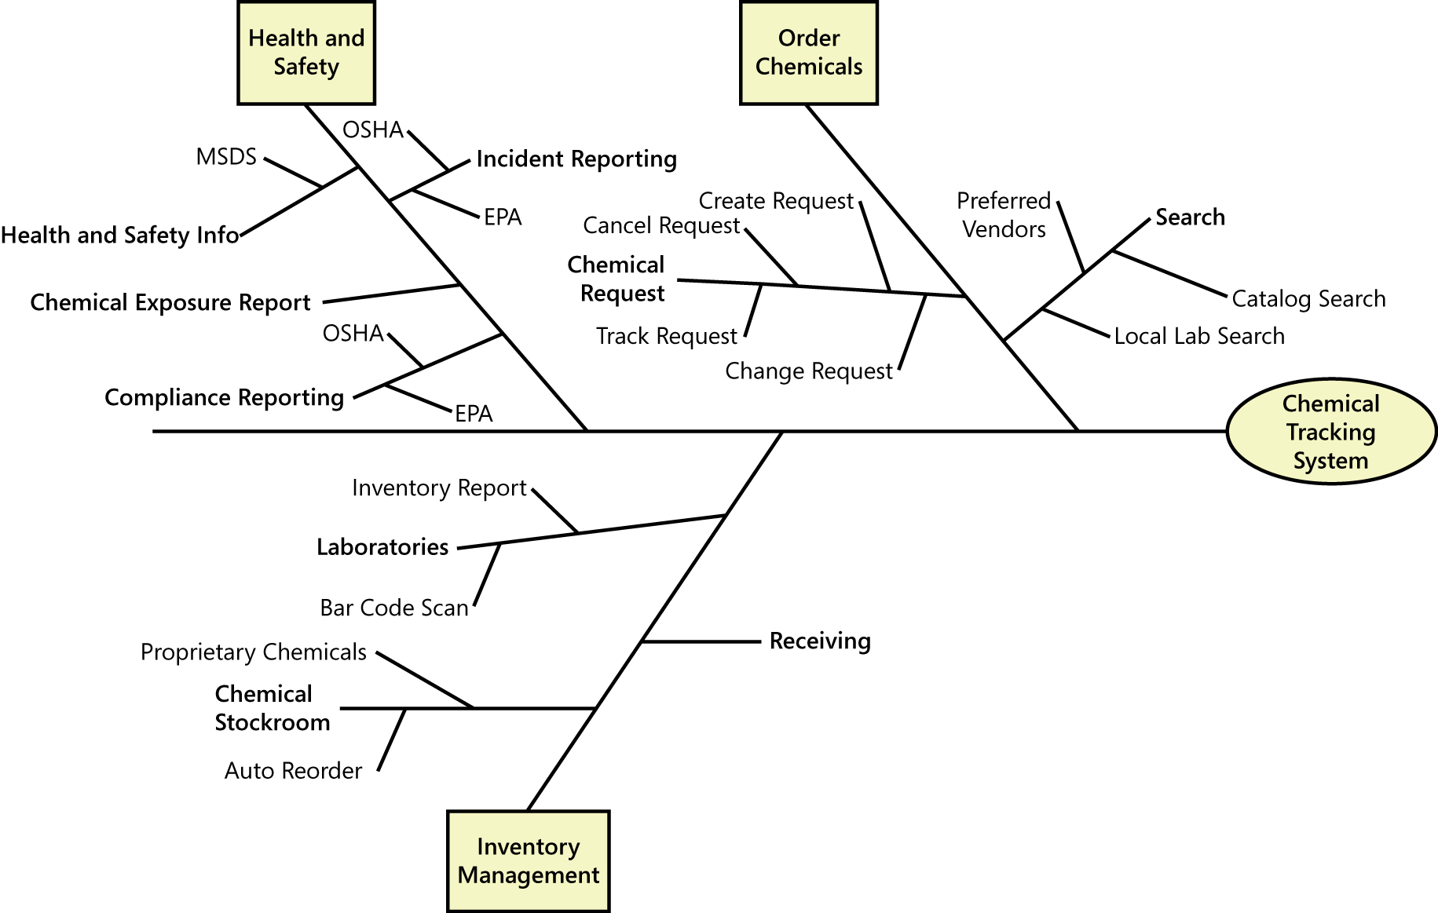

Slide 18
Feature Tree
When planning a release or an iteration, you can define its scope by selecting a specific set of features and subfeatures to be implemented.
You could implement a feature in its entirety in a specific release, or you could implement only a portion of it by choosing just certain L2 and L3 subfeatures.
Future releases could enrich these rudimentary implementations by adding more L2 and L3 subfeatures until each feature is fully implemented in the final product.

Slide 19
Event list
An event list identifies external events that could trigger behavior in the system.
The event list depicts the scope boundary for the system by naming possible business events which are
triggered by users,
time-triggered (temporal) events,
signal events received from external components, such as hardware devices.
The event list only names the events; the functional requirements that describe how the system responds to the events would be detailed in the SRS by using event-response tables.

Slide 20
An event list is a useful scoping tool because you can allocate certain events to be implemented in specific product releases or development iterations.

